Slide 1
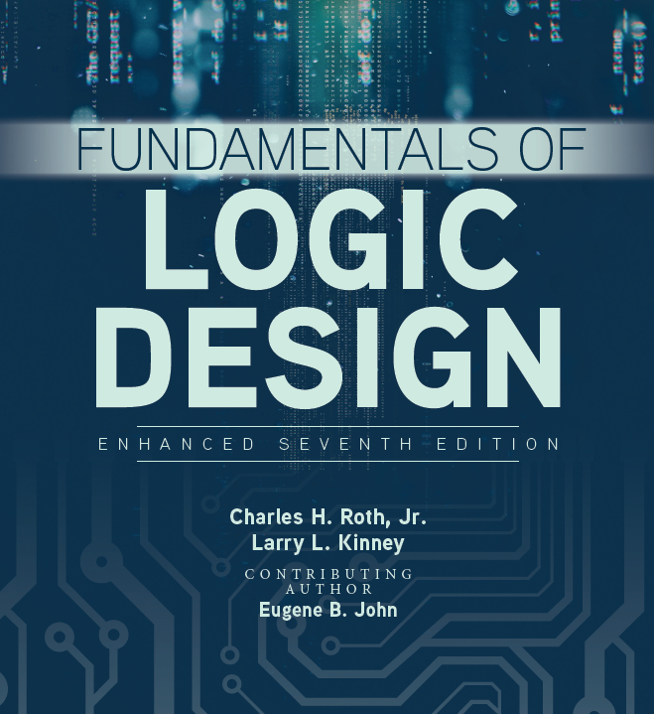

Unit 2
Propagation delay

Slide 2

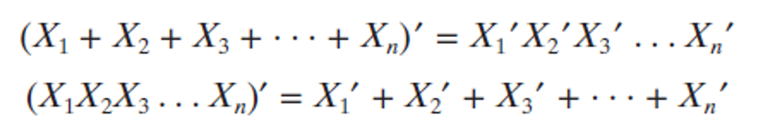
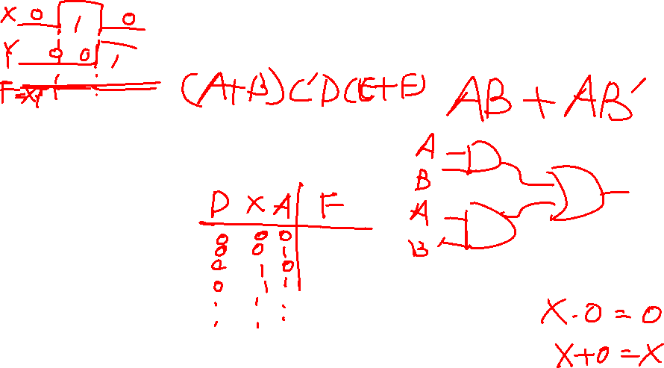
Review for last class
Boolean functions
DeMorgan Laws
The complement of the product is the sum of the complements.
The complement of the sum is the product of the complements.

Slide 3
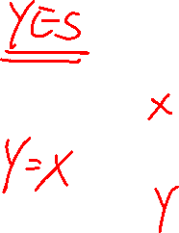
Gate delay
In reality, there is always a gate delay
Gate delay – the length of time it takes for an input changes to result in the corresponding output change
1
0
1
0
Input
t
t
t = 0.3 ns
G
G
G
Output
0 0.5 1 1.5
Time (ns)
Gate delay is a function of gate type, number of inputs, underlying technology, and circuit design of the gate.

Slide 4
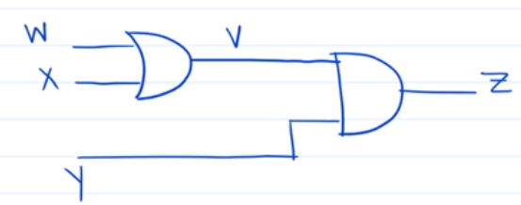
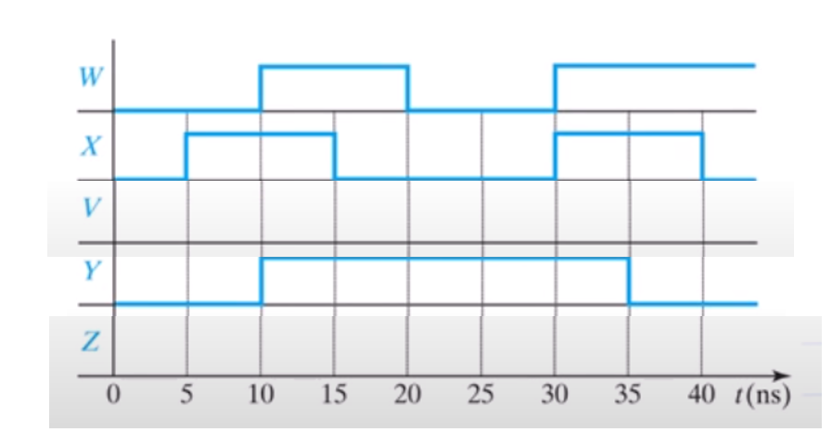
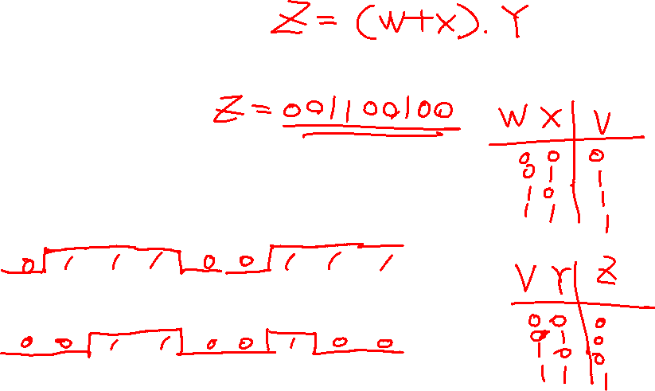
Examples: no propagation delay

Slide 5
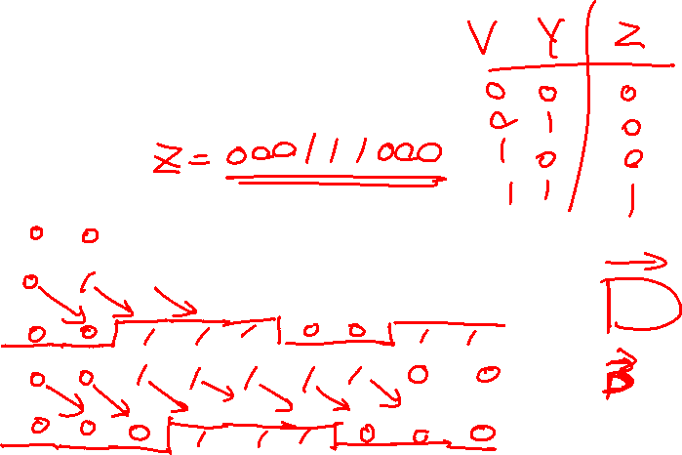
Examples: 5ns propagation delay for each gate

Slide 6
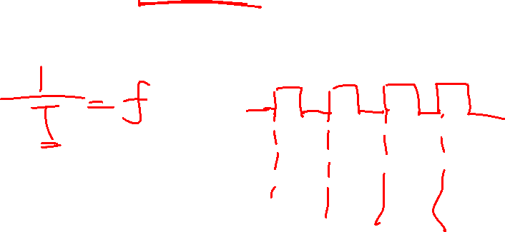
Questions:
The Guinness World Record for the highest CPU clock rate is an overclocked, 8.723 GHz AMD Piledriver-based FX-8370 chip. Why cannot we keep increase the maximum frequency of the computer?

Slide 7
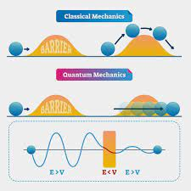
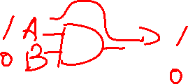
Ｍoore’s law: the number of transistors in a dense integrated circuit (IC) doubles about every two years
When the size of the integrated circuit is reduced to the atomic level, electrons can penetrate the insulating layer through the quantum tunneling effect, and the devices will be disabled.

Slide 8
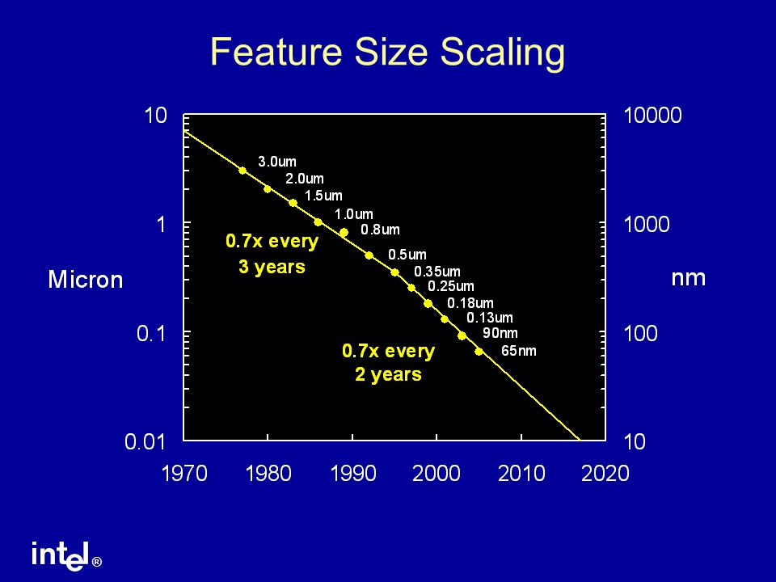
End of Moore’s Law

Slide 9
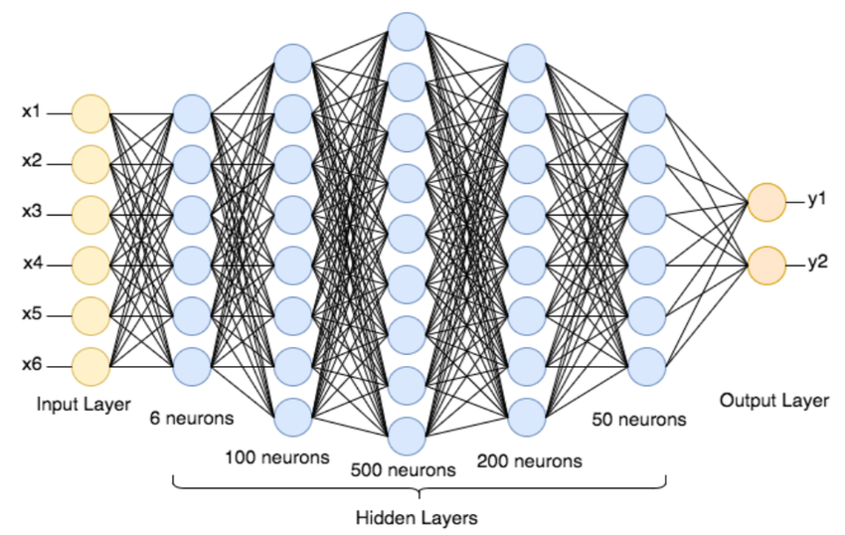
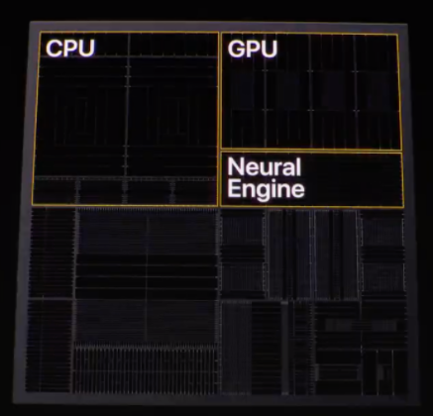
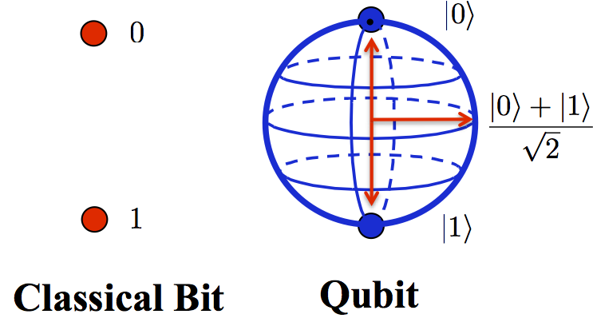
New directions
Better algorithms and software
More specific chips
Quantum computing

Slide 10
